Slide 1
Website Presentation
Super Team Formation Unit (STFU)

Slide 2
STFU Members
Lachlan George (Project Leader)
Bodaniel Jeanes (Senior Technical Advisor)
Ross Brackstone (Senior Design Engineer)

Slide 3
Purpose
  To compliment your other promotional strategies
  To help cope with your anticipated increase in demand for information and ticketing
  To expand new marketing opportunities (sales and merchandise)
  To better utilise existing your resources

Slide 4
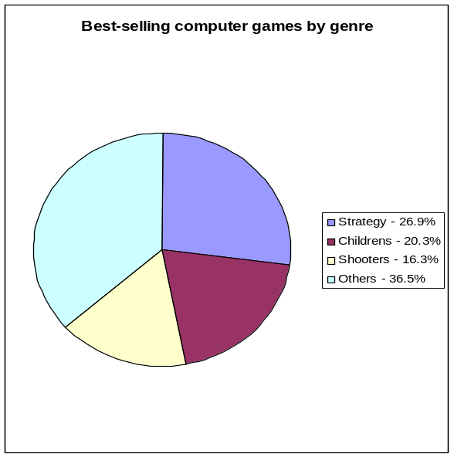
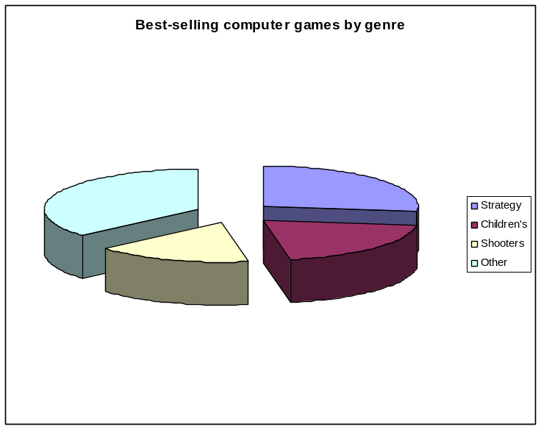
Audience Demographic and Genre
Role Playing (Online and Single Player) | First Person Shooters | Strategy
World of Warcraft Dungeons & Dragons Online: Stormreach Guild Wars Elders Scrolls 4: Oblivion | Battlefield 2 Call of Duty 2 | Star Wars: Empire at War Lord of the Rings: Battle for Middle Earth II Civilization 4 Age of Empires III
Entertainment Software Association (2005)

Slide 5
Showcase
Insert Screenshot of SHOWCASE here

Slide 6
Echo Bay Region and Lifestyle Information
Insert Screenshot of ECHO BAY REGION.. here

Slide 7
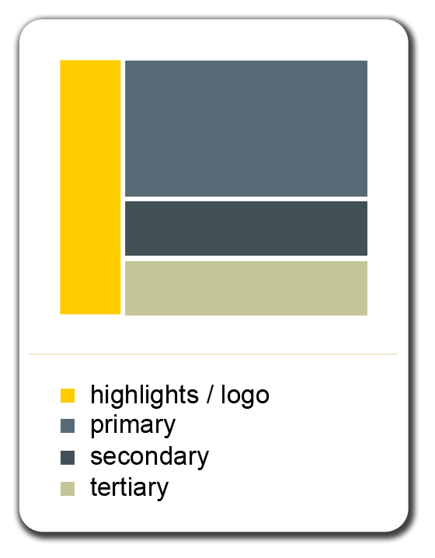

Colour and Typography
Verdana:
The quick brown fox jumped over the lazy dog.
The quick brown fox jumped over the lazy dog.
Arial (Helvetica on Mac):
The quick brown fox jumped over the lazy dog.
The quick brown fox jumped over the lazy dog.
Microsoft Sans Serif:
The quick brown fox jumped over the lazy dog.
The quick brown fox jumped over the lazy dog.
Georgia:
The quick brown fox jumped over the lazy dog.
The quick brown fox jumped over the lazy dog.

